Slide 1
MORTALITY RISK FACTOR ANALYSIS

Slide 2
Name:Gopalakrishnan Kumar IIT- B Alumnus
Occupation: Consultant Data Scientist
LinkedIn URL: https://www.linkedin.com/in/gopalakrishnan-kumar-a73301110/

Slide 3

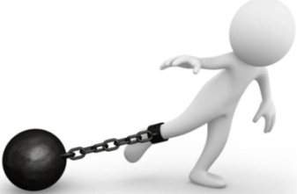
Project Goals
Objectives
Constraints
Limited dataset is not giving sufficient information
Mortality Risk also depends on several factors such as intensity of disease, type of medication etc.
Identify the factors which are influencing mortality risk

Slide 4
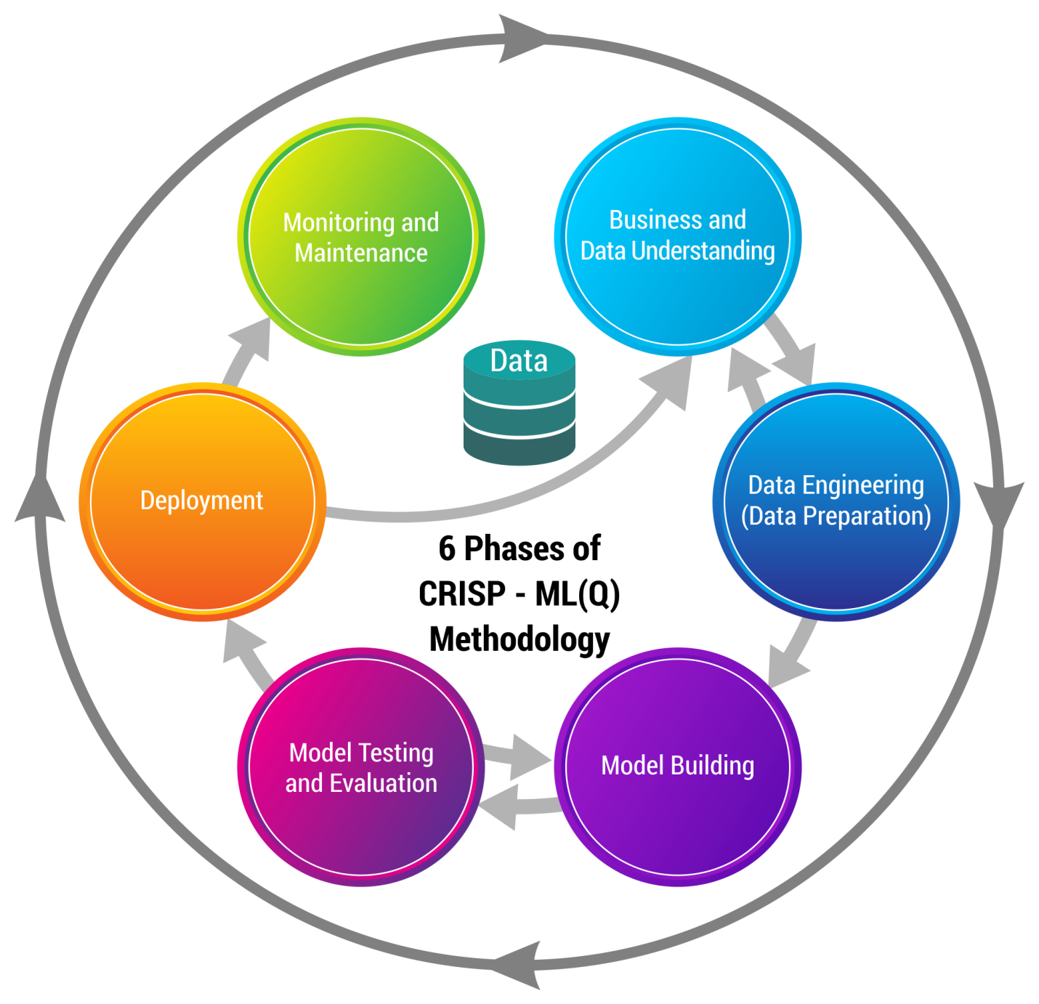
CRISP-ML(Q) Methodology

Slide 5




Technical Stacks
Microsoft Excel - MS Excel is a commonly used Microsoft Office application. It is a spreadsheet program which is used to save and analyze numerical data. I extracted the data from the server and stored it in Excel for later use.
MySQL - SQL (Structured Query Language) is a standardized programming language that's used to manage relational databases and perform various operations on the data. We used it to warehouse the data.
Spyder- Spyder is an open-source cross-platform integrated development environment (IDE) for scientific programming in the Python language. Spyder integrates with a number of prominent packages in the scientific Python stack, including NumPy, SciPy, Matplotlib, pandas, IPython, SymPy and Cython, as well as other open-source software. I Used Spyder to develop python code
Tableau - Tableau helps people see and understand data. Its visual analytics platform is transforming the way people use data to solve problems. I primarily used Tableau to make more enhanced visualizations on my data subsets.

Slide 6

Data Preparation
Data used for training the model is genuine best known to our knowledge collected from clients for further analytics.
Data cleansing
And additional steps for data preparation
Dropped the irrelevant column.
Median imputation for missing data.
2195 Duplicates detected.
Dropped a zero variance column.
We have an unnamed column.

Slide 7

Exploring (Exploratory Data Analysis)
Now during the exploration phase, we try to understand what patterns and values our data has. We’ll be using different types of visualizations and statistical testings to back up our findings. This is where we will be able to derive hidden meanings behind our data through various graphs and analysis.
Correlation can be positive (increase in one value of feature increases the value of
the target variable) or negative (increase in one value of feature decreases the value of the target variable)
Heatmap makes it easy to identify which features are most related to the target variable,
we will plot heatmap of correlated features using the seaborn library.
While seeing the heatmap we conclude that AGE factor has good correlation with MORT_RISK as compared to other factors.
Exploratory Data Analysis

Slide 8
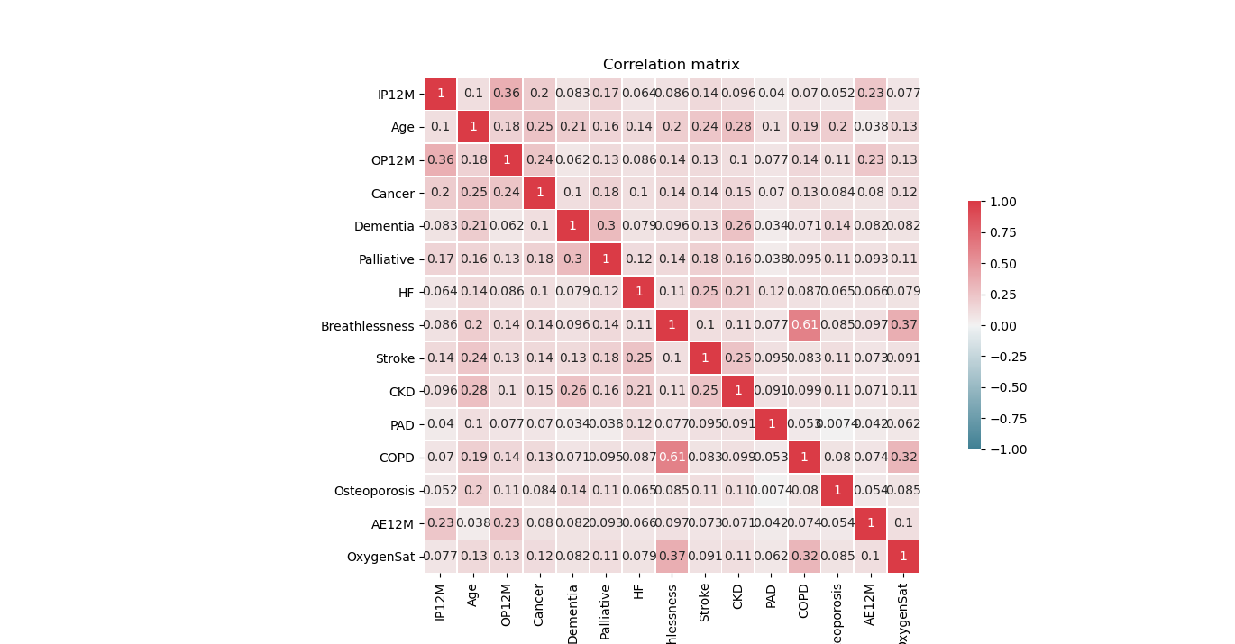
Correlation Matrix of Top 15 Features:

Slide 9
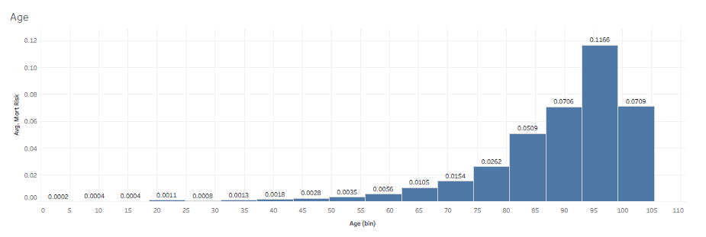
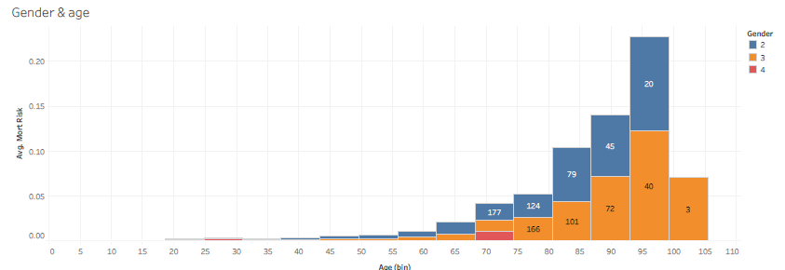
Bivariate Analysis (Factors Vs. Mortality Risk)
Bivariate analysis is analyzing two variables. categorical scatter plot is used to check for the correlation between two variables.
Age Vs. Mort_Risk:
People age has greater than 60 has high value of mortality risk as compared to person people age less than 60
Age and Gender Vs. Mort_Risk:
Gender 3 people are effecting more than other genders with respect to age

Slide 10
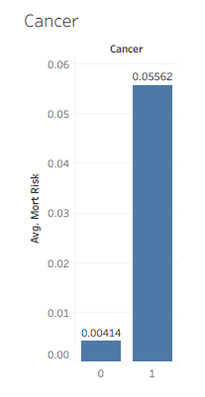
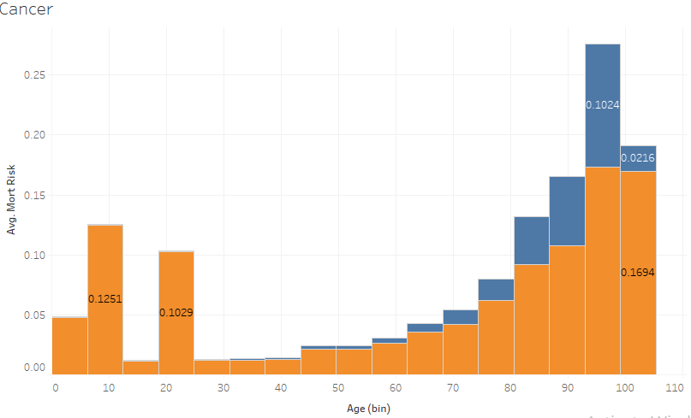
1 = present
0 = Not present
#Cancer VS Mortality Risk
Average Mortality Risk of people who is having cancer is 5.562%
Here age group less than 24yrs and greater than 74 yrs are having high mort_risk compared to the age group of 25 to 73.

Slide 11
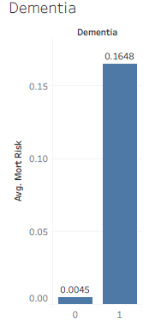
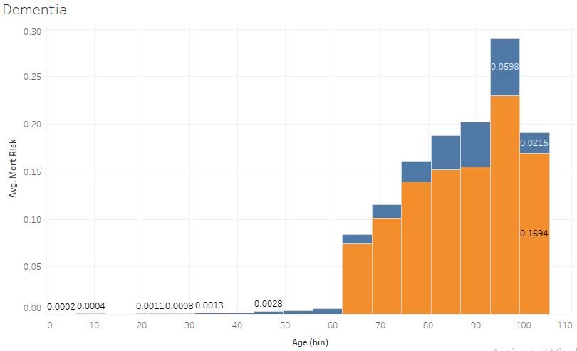
1 = present
0 = Not present
#Dementia VS Mortality Risk
Average Mortality Risk of people who is suffering with dementia is 16.48%
Here age group greater than 63 yrs are having presence of disease and mort_risk and less than 63yrs people are having very less impact.

Slide 12
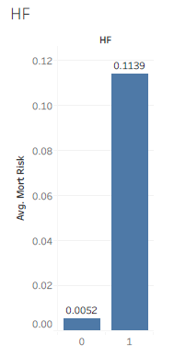
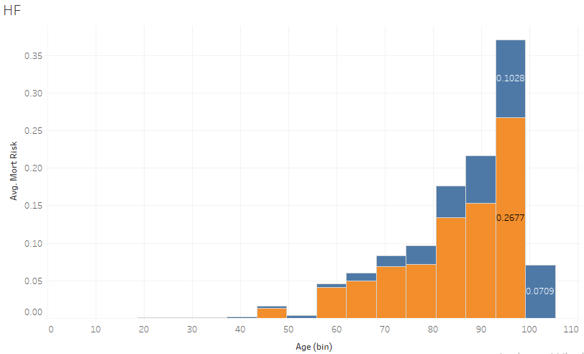
1 = present
0 = Not present
#HF VS Mortality Risk
Average Mortality Risk of people who is having Heart Failure is 11.39%
Here age group of more then 55yr having presence of disease & has high mortality risk.

Slide 13
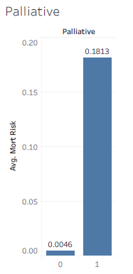
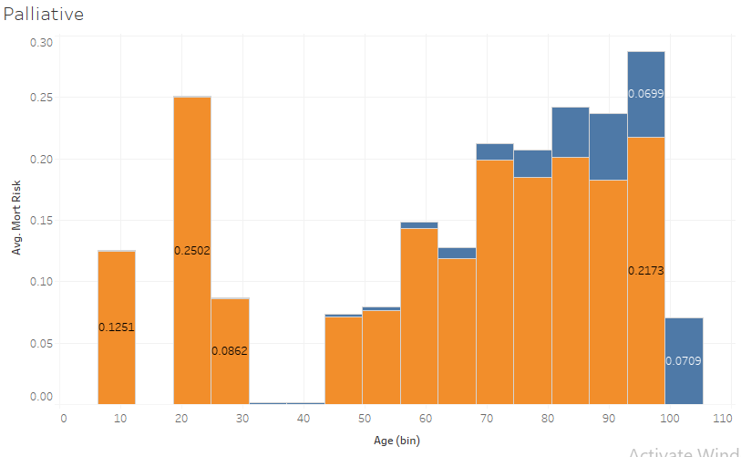
1 = present
0 = Not present
#Palliative VS Mortality Risk
Average Mortality Risk for Palliative is 18.13%
Palliative is having high impact irrespective of age group

Slide 14
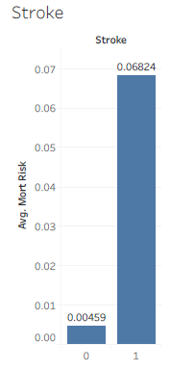
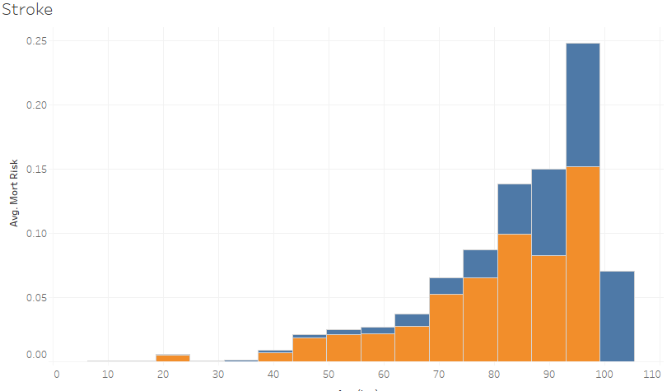
1 = present
0 = Not present
#Stroke VS Mortality Risk
Stroke is present in the people majorly from the age of 38 and it is directly proportional to the age, when the age is increasing, mort risk wrt stroke is also increasing
Average mortality risk for the people who is suffered from a stroke is 6.824%

Slide 15
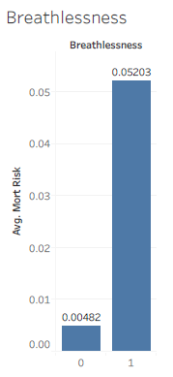
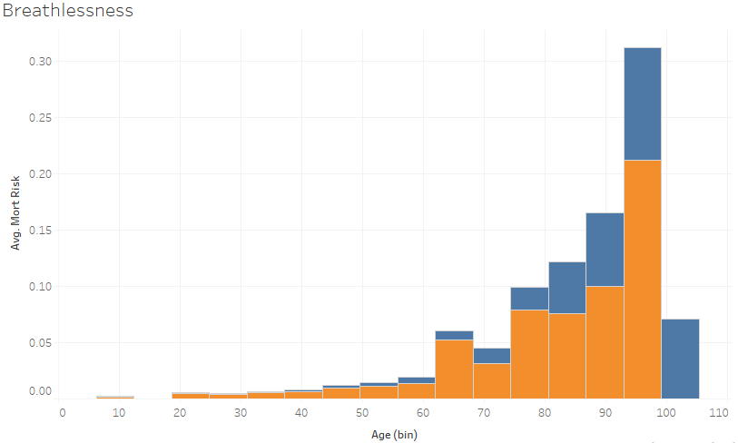
1 = present
0 = Not present
#Breathlessness VS Mortality Risk
Average mortality risk for the people who is having breathlessness problem is 5.203%
Mort risk for breathlessness is directly proportional to age

Slide 16
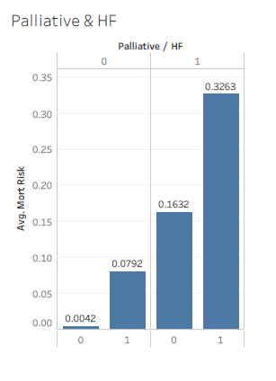
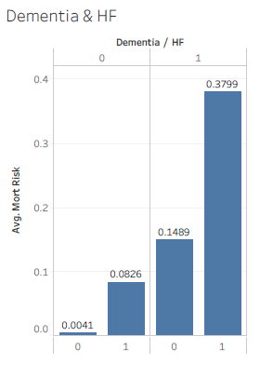
1 = present
0 = Not present
#Palliative & HF VS Mortality Risk #Dementia & HF VS Mortality Risk
Average mort risk for the people who is having both palliative and HF is 32.63%
Average mort risk for the people who is having both Dementia and HF is 37.99%

Slide 17
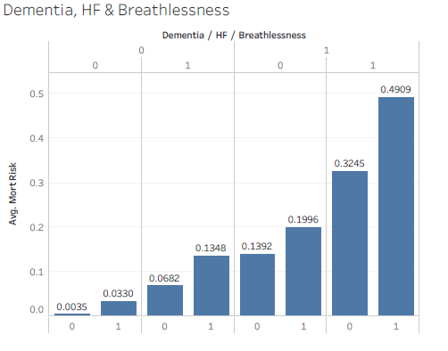
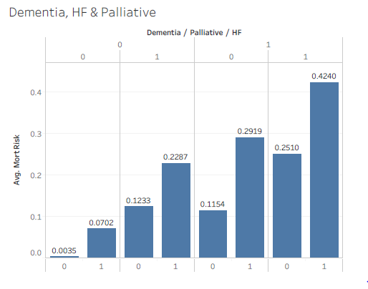
1 = present
0 = Not present
#Dementia, HF & Breathlessness VS Mortality Risk #Dementia, HF & Palliative VS Mortality Risk
Average mort risk for the people who is having Dementia, Breathlessness and HF is 49.09%
Average mort risk for the people who is having Dementia, Palliative and HF is 42.4%

Slide 18
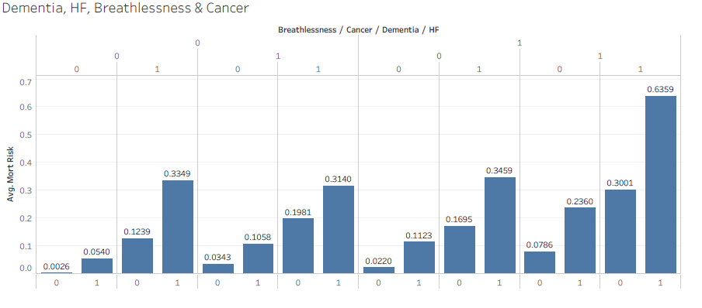
1 = present
0 = Not present
#Dementia, HF, Breathlessness & Cancer VS Mortality Risk
Average mort risk for the people who is having Dementia, Breathlessness, HF & Cancer is 63.59%

Slide 19
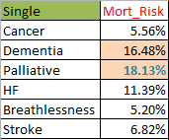
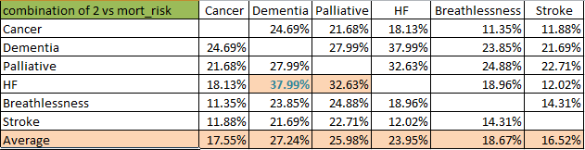

Features Vs. Mortality Risk Tabular Values:

Slide 20

Model Building

Slide 21
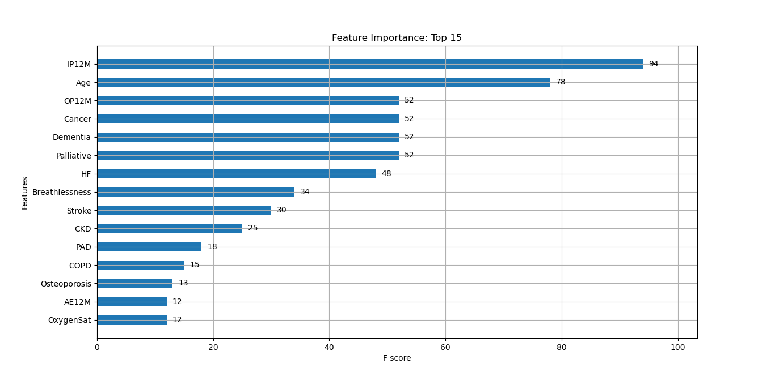
Model Description
Algorithms used:
XGB Regression with max depth 3 to find feature importance.
Survival Analysis with in-patient hospital activity as the time component.
Descriptions:
Split the data into training (80%) & testing (20%)
Feature Importance was obtained after using XGB Regression.

Slide 22
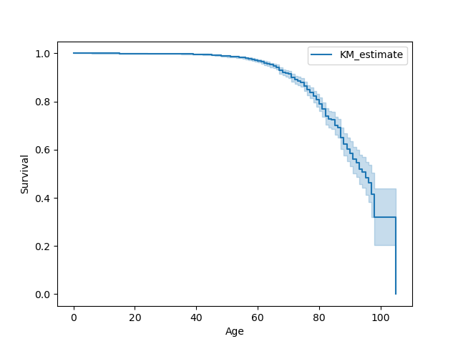
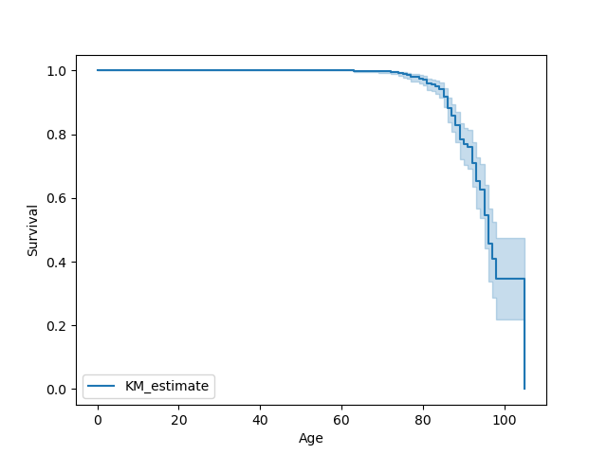
Survival Analysis
Survival analysis is a branch of statistics for analyzing the expected duration of time until one event occurs, such as death in biological organisms and failure in mechanical systems.
For this project, I have taken into account the Top 4 diseases from the feature importance plot as the combination of these is giving high mort risk:
Cancer
Dementia
Breathlessness
Heart Failure
The plot alongside is the survival of cancer patients with respect to their age
The plot alongside is the survival of Dementia patients with respect to their age

Slide 23
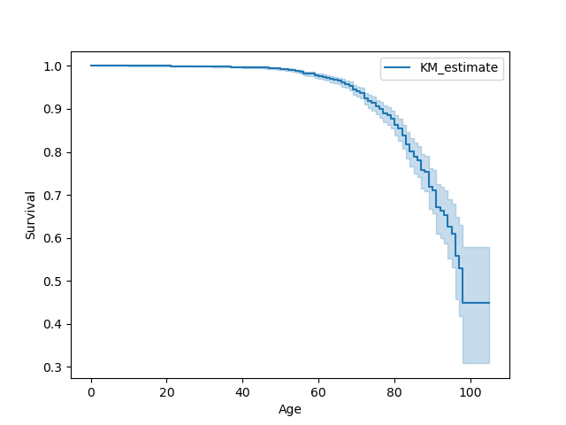
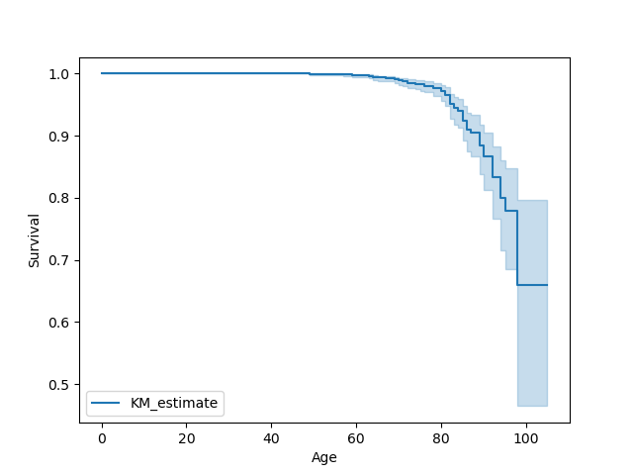
Survival Analysis
The plot alongside is the survival of Breathlessness patients with respect to their age
The plot alongside is the survival of HF patients with respect to their age

Slide 24

Deployment Strategy
Web Based
Mobile Based
Cloud Based
Enterprise Based

Slide 25


